Slide 1

- Mid-term Presentation -

Slide 2
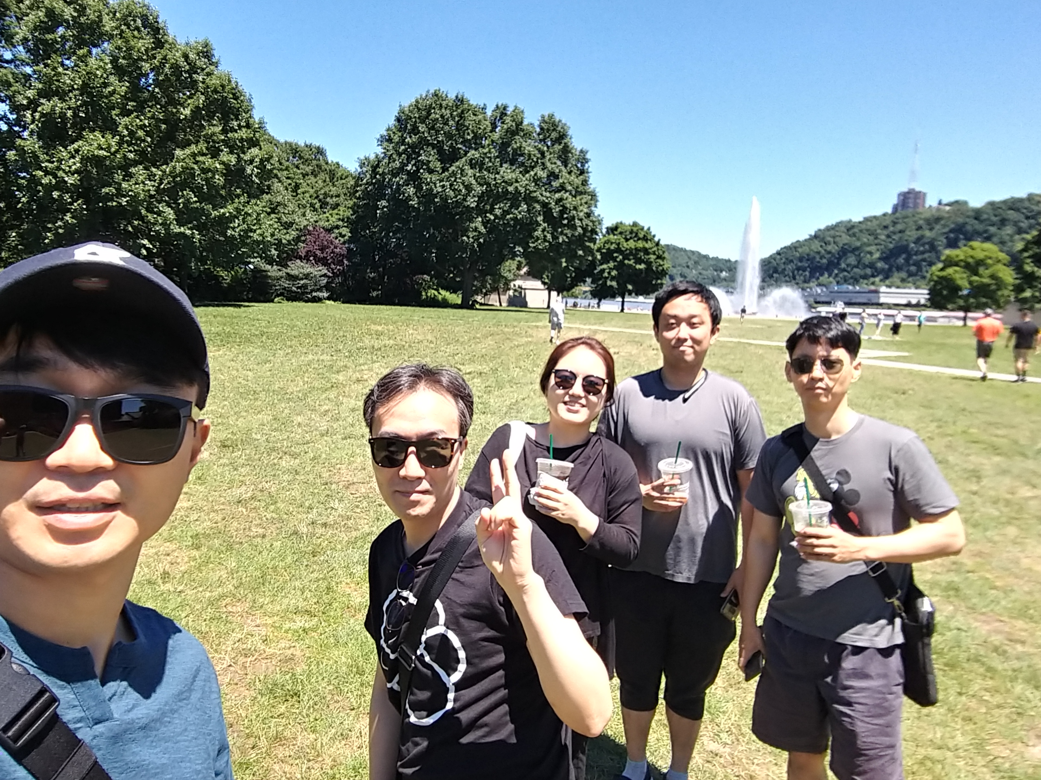
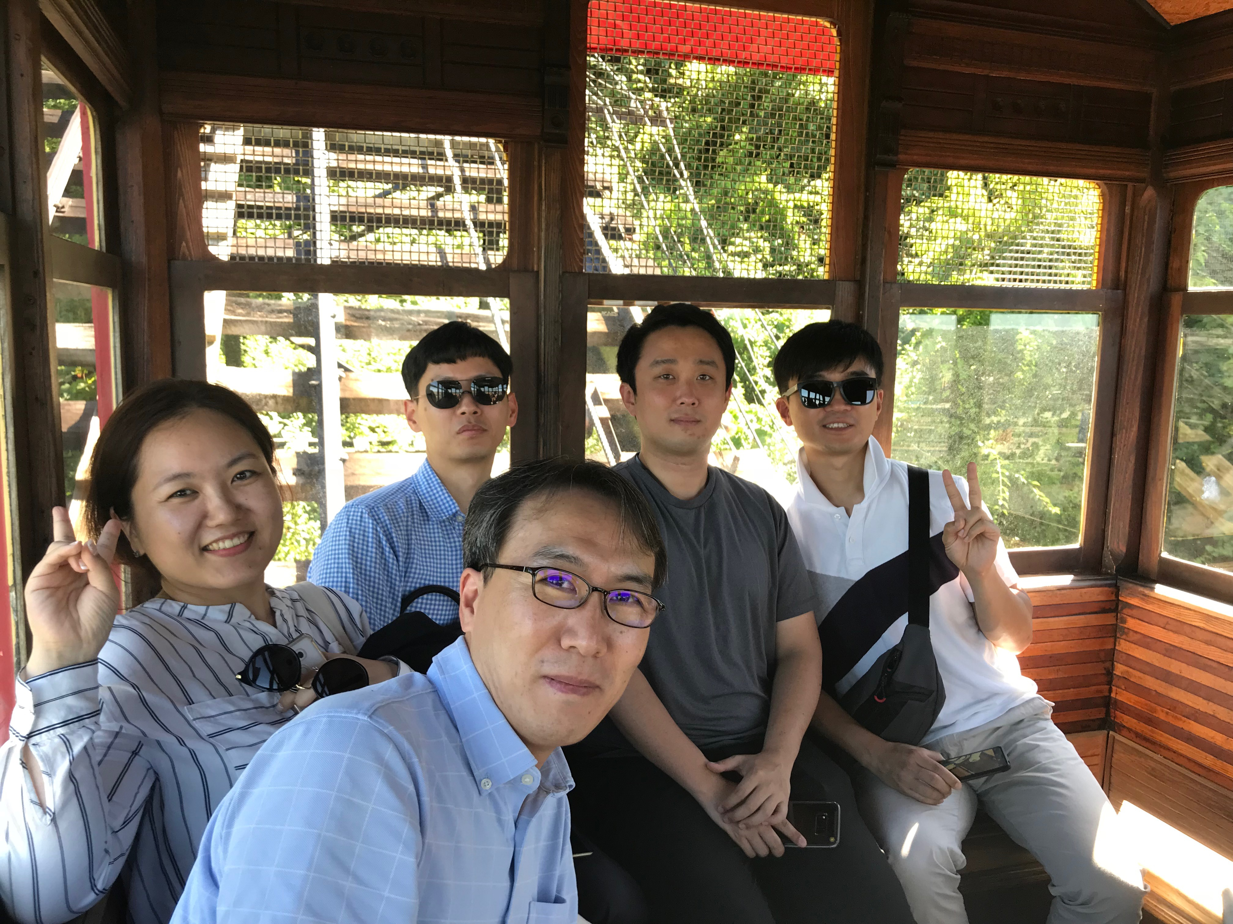
Team introductions
Team members (main role)
Sungho Chin (Team & Project Lead)
Jonggu Lee (Code Review Lead)
Sujung Lyu (Refactoring Lead)
Jinhyuk Yang (Static Analysis Lead)
Hyoyeon Hwang (Plan & Test Lead)
Team Goal :
“Studying and Understanding of SDET Culture and Techniques”, not dancing or singing!!
Team Process :
Every member should be involved in every quality management process.
5 hrs for project / day, 1 project / day, 1 mentoring meeting / week

Slide 3
Project introductions
Project Goal
“Tracking bugs and defects until our customer(jeff) is satisfied.”
Quality Goals
Testability : line coverage : 90%, branch coverage : 80%, mutation coveraghttps://github.com/sunghochin/share_doc.gite : 90%
Functional correctness : unit test - pass 100%
Functional suitability for new features : 60%
Usability (optional) : improve game command and message visibility (can be play the game with the less use ‘help’ command)

Slide 4
Project Plan
Project Plan
Quality Goals

Slide 5

Team plans
Strategic/Tactical
There are no unpredictable errors in tartan system.
Focus on Testability
TDD about new feature
Quality
Vaild Test(no simple coverage ratio)
Project tracking
Time Log Trend (burn down chart)
Discussion of collected data
Wiki : https://sdet-bts.atlassian.net/wiki/spaces/SDET/overview
JIRA : https://sdet-bts.atlassian.net/secure/RapidBoard.jspa?rapidView=1&projectKey=SDET
Sonar : http://40.74.87.211:9000/projects?sort=-analysis_date

Slide 6
Quality activities
It is not a formal quality system step.
Review of check the quality of acquired sw.
Pre-Test
Ad-Hoc (Experience-based test design technique)
Code review
Team (Technical) Review
Refactoring
Sonar, testability
Unit test
White Box testing(Coverage) + Black Box testing(functionality)
Integration test
Scenario testing
System test
Scenario testing, Ad-hoc Testing, Combination testing, BVA
Develop/Unit test
+ TDD
Code review
Integration test
Sys test

Slide 7
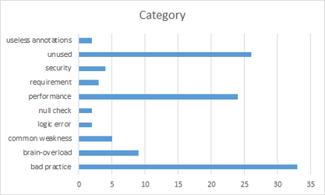
Code Review
Goal
Understanding system of Tartan Adventure.
checking correspondence between Spec. and Code
detecting Code defect
Working Hours
Period : 6/21 ~ 26
Actual / Planned : 36.5h / 50h (2h * 5days * 5 members)
Deliverables
number of Defects : 110
Lessons Learned
Vague requirements made code review hard.
Code review is one of good way to understanding System.

Slide 8
Refactoring & Re-Work
Goal
Improving Testability
Improving Code smells in SonarQube (by 1day debt)
Working Hours
Period : 7/9 ~ 13
Actual / Planned : ***/ 50h (2h * 5days * 5 members)
Deliverables
Refactoring Status :
SonarQube Trand :
Lessons Learned
Refactoring is indispensable for Testability
Monitoring method for Field Status is needed to know changed status.
- For this, We discussed for changing private fields to public fields
- Finally, we added getter & setter methods.
Method should return about that’s result of procedure.

Slide 9
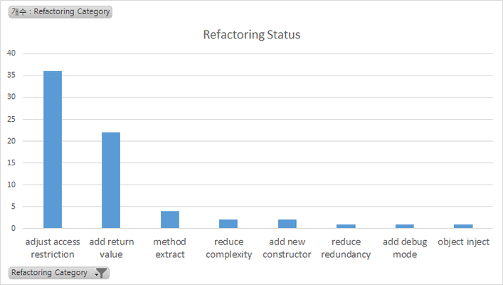
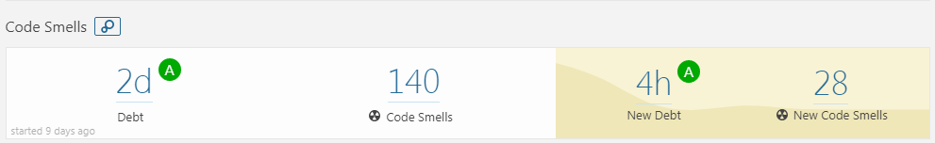
Refactoring & Re-Work
Refactoring Status
Category | num | Graph
adjust access restriction | 36
add return value | 22
method extract | 4
reduce complexity | 2
add new constructor | 2
reduce redundancy | 1
add debug mode | 1
object inject | 1

Slide 10
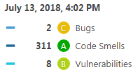
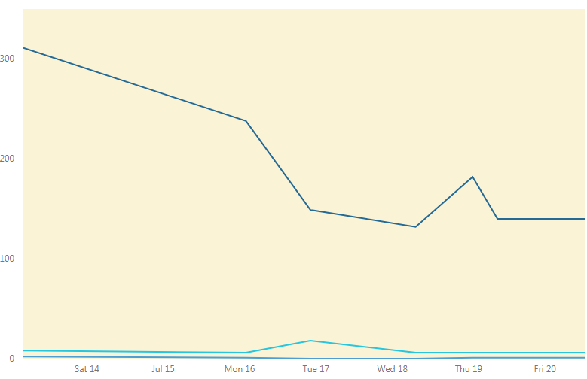
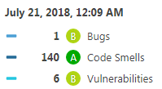
Refactoring & Re-Work
SonarQube Trand

Slide 11
Pre-Test
GOAL
Quality ‘smell’ of the tartan system
Review of requirements (at system level)
Participants : Sujung Lyu
Planned Effort: 2 h
Actual Effort : 5 h
Technique : Ad-Hoc
Outputs
TestCase : PreTest - TestCase(26)
Defect : JIRA ISSUE (15)
Map of Game
Review
Understanding the tartan system
Ambiguous requirements and unexpected gaming behavior

Slide 12

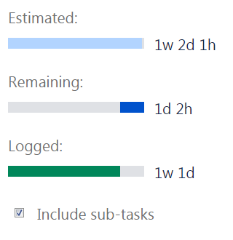
Quality activity – Unit test
Goal : Satisfying code coverage
Completion criteria
90% statement coverage
80% branch coverage
Participants : All members
Planned Effort : 45h (7/16~20, 3hours a day) -> 73h
Actual Effort : 64h
Outputs
Number of unit-test per class : 10 (241/24)
Jacoco test report
Defect list : 4 (SDET-47, SDET-48, SDET-51, SDET-54)
Review
Should simple code be included in the Unit test?
→ Our team's decision: don’t include
To effectively write the Unit test, we need a detailed specification.
1)
1) methods without conditional statements, getter/setter methods
Notes:
예상 질문
유닛테스트 작성을 위해 디테일한 스펙을 정리 했는가?

Slide 13
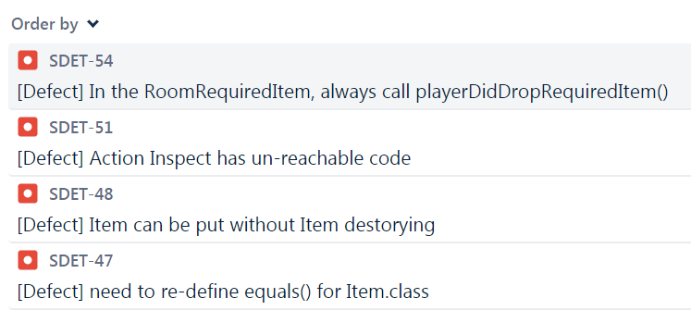
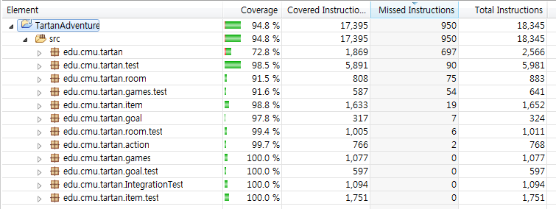
Quality activity – Unit test
Defect list : 4 (SDET-47, SDET-48, SDET-51, SDET-54)
Jacoco test report
Notes:
예상 질문
유닛테스트 작성을 위해 디테일한 스펙을 정리 했는가?

Slide 14
Quality activity – Integration test
Goal : Verify core sequence consistency (Risk based test)
Completion criteria
Test case result : 100% pass
Participants : All members
Planned Effort : 45h (7/18~20, 2hours a day) -> 19h 30m
Actual Effort : 15h 40m
Outputs
Test case :
Jacoco test report (pass rate) :
Defect list : 1 (SDET-46)
Review
Do small projects need integration testing?
In the tartan project, the modules are already integrated, should we do the integration test?
Notes:
예상 질문

Slide 15
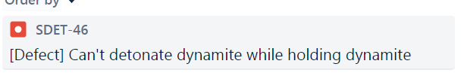
Quality activity – Integration test
Defect list : 1 (SDET-46)
Jacoco test report
Notes:
예상 질문

Slide 16
System test
Goals
Verify requirements from the user's perspective.(2018LGSDETProject.pdf)
Especially, Use-Cases will be mainly verified.
Test Participants
Maybe, it will be 2 persons.
Test Schedule
Total Man Hours : 50 hours (5days / 5hours per day / 2persons)
Periods : 7/19~25
Test Outputs
System Test Case , System Test Execution Result.
Defect List (it is managed by JIRA System)
System Test Scenario based on Test Case.
Argument Point
shoud we have to implement automation test system?

Slide 17
Next Plan for remaining period.
System Test (7/19 ~ 7/25)
As mentioned before, two people will do it.
We will test not only the existing features but also the new features to be developed.
Mutation Test
Maybe, it will be one person.
We are going to test game class because it is very related to the operation of the game.
Implement New Features. (7/23~27)
3 peoples (Except for the personnel required for the system test, the rest peoples concentrate on new functions.)
Integration Test for New Features. (7/26~27)
the number of tester is not determined yet. (New Feature Integration Testing was not decided whether it was a developer or a tester.)

Slide 18
Next Plan for remaining period. (cont.)
System Test2 (7/30 ~ 7/31)
This is the second system test to see if existing defects are resolved successfully and if new functionality is working.
Documentation (8/1 ~ 8/2)
Document output and prepare for final presentation.

Slide 19
Tools
CI : Github + Jenkins (http://40.74.87.221:8080)+ sonaQube
Source repository : github (https://github.com/sunghochin/TartanAdventure)
Quality Tool : SonarQube (http://40.74.87.211:9000/projects)
document configuration : wiki page (https://sdet-bts.atlassian.net/wiki/spaces/SDET/overview)
issue tracker : jira (https://sdet-bts.atlassian.net/secure/RapidBoard.jspa?projectKey=SDET&rapidView=1)
Coverage library : jacoco, pitest
Auto trigger build
Static analysis
build
Coverage integration
source commit
Measure coverage

